Slide 1


Mansoura University Faculty of Computers and Information Second Semester- 2020-2021
Computer Graphics
Grade: 2nd Year (General –BIO)
Prepared by: Dr. Haitham El-Ghareeb,
Dr.-Waleed Mohamed, Dr.-Ibrahim El-Hasnony

Slide 2
Chapter 3
Color theory

Slide 3
Color
Color is an attribute of objects (like texture, shape, smoothness, etc.).
Any method for explaining the properties or behavior of color within some particular context is called a color model
A color model is an abstract mathematical model describing the way colors can be represented as tuples of numbers, typically as three or four values or color components. When this model is associated with a precise description of how the components are to be interpreted (viewing conditions, etc.), the resulting set of colors is called "color space”.
No single model can explain all aspects of color, so we make use of different models to help describe different color characteristics.
There are different methods for generating displays on video monitors. Several other color descriptions are useful as well in computer-graphics applications. Some methods are used to describe color output on printers and plotters, some are used for transmitting and storing color information, and others are used to provide a more intuitive color-parameter interface to a program.

Slide 4
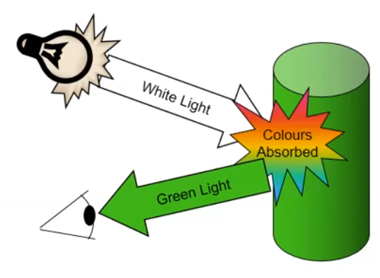

Why is Color Difficult and important?
Color importance:
Color is an excellent descriptor: Suitable for object Identification and Extraction.
Discrimination: Humans can distinguish thousands of color shades and intensities but few shades of gray levels.
Color of an object depends not only on the object itself, but also on the light sources illuminating it, the color of surrounding area, and on the human visual system (the eye/brain mechanism)
Some objects reflect light (wall, desk, paper), while others transmit light (cellophane, glass)

Slide 5

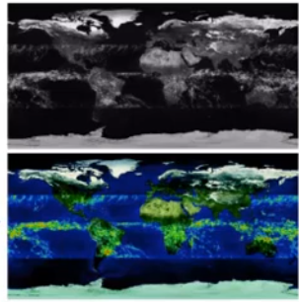
Color processing
Full-Color Image Processing
Color is acquired with a full-color sensor
Pseudo-Color Image Processing
Assigning colors to monochrome images

Slide 6
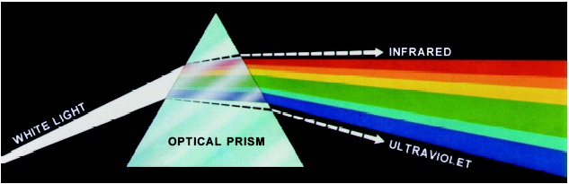
Color and light
Newton Experiments (Spectral Analyzer)
When passing a beam of sunlight through a prism the light decomposed to a spectrum of colors.
Emerging light is not longer white but a continuous spectrum of color from violet to red.
Six broad region: violet, blue, green, yellow, orange, and red.

Slide 7
Chromatic Light
Light: is an electromagnetic wave. Its color is characterized by the wavelength content of the light.
We perceive electromagnetic energy having wavelengths in the range 400-700 nm as visible light.

Slide 8
Chromatic Light (cont.)
Light is fundamental of color vision
Achromatic light (BW Television): Intensity!
Chromatic light (Color TV): Radiance, luminance, and Brightness
Light is an Electromagnetic waves
The wave which wavelength (pure) is between ~400nm and ~700nm is detectable by human eye.
λ < 400nm: Ultraviolet
λ > 700nm: Infrared

Slide 9
Chromatic Light quantities
Radiance:
Total amount of energy that flows from light source (W)
Luminance:
The amount of energy that an observer perceives from light source. (IR case: R may be high while L is zero)
Brightness:
Subjective description, practically impossible to measure.

Slide 10
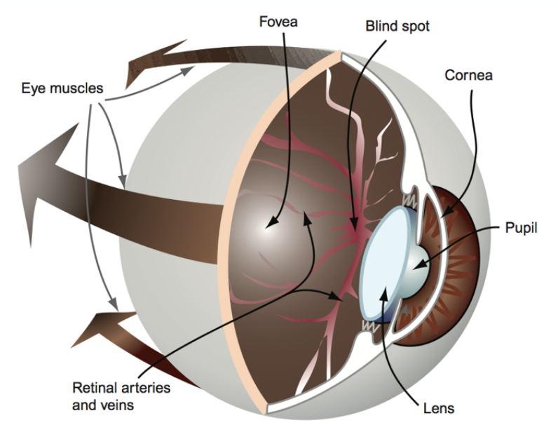
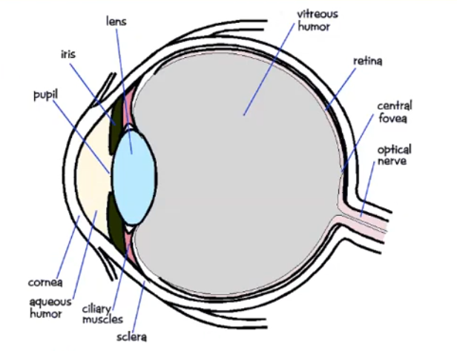
Human visual system

Slide 11
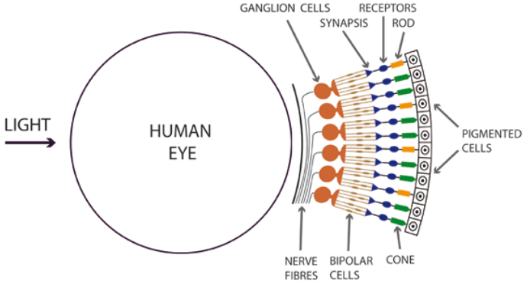
Human visual system (Cont.)
Light hit the retina which contain photosensitive cells that convert the spectrum into a few discrete values. There are two types of photosensitive cells
Rods!
Approximately 100-150 million rods.
Non-uniform distribution across the retina.
Sensitive to low-light levels.
Cones!
Approximately 6-7 million cones.
Sensitive to daytime-light levels.
Detect color by the use of 3 different pigments:
Red (L cone) : 564-580nm wavelengths (65% of all cones)
Green (M cone) : 534-545nm (30% of all cones)
Blue (S cone) : 420-440nm (5% of all cones)

Slide 12
Color fundamentals
To distinguish a color from another
Hue, Saturation, and Brightness
Hue: Dominant color (wavelength) perceived by an observer. (Red, Orange, Yellow, and etc.)
Saturation: relative purity of color or the amount of white light mixed with a hue.
Pure colors are fully saturated.
Pink is less saturated.
Brightness: chromatic notion of intensity.
Lightness is the relative brightness or darkness of a particular color, from black (no lightness) to white (full lightness).

Slide 13

Achromatic Light
Achromatic Light: “without color,” quantity of light only
Called intensity, luminance, or measure of light’s energy/brightness
The psychophysical sense of perceived intensity
Gray levels (e.g., from 0.0 to 1.0)
Seen on black and white displays
Eye is much more sensitive to slight changes in luminance (intensity) of light than slight changes in color (hue)

Slide 14
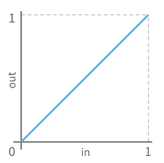
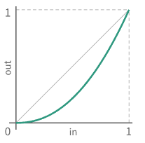
Gamma Correction
Human visual response better at distinguishing darker shades
Greyscale bars that increase by a constant amount of luminosity:
Greyscale bars with luminosity increasing according to a power law:
The smoother visual appearance of the second means it is more perceptually uniform

Slide 15
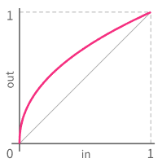
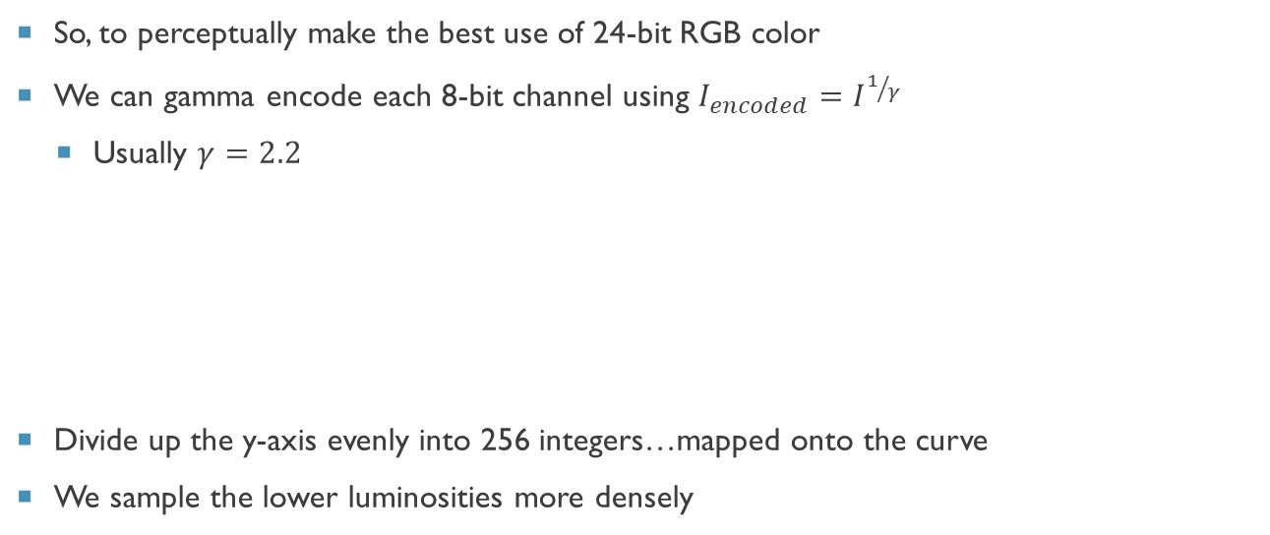
Gamma Encoding
So, to perceptually make the best use of 24-bit RGB color
We can gamma encode each 8-bit channel using $I_{encoded}=I^{1/γ}$
Usually $γ=2.2$
Divide up the y-axis evenly into 256 integers…mapped onto the curve
We sample the lower luminosities more densely

Slide 16
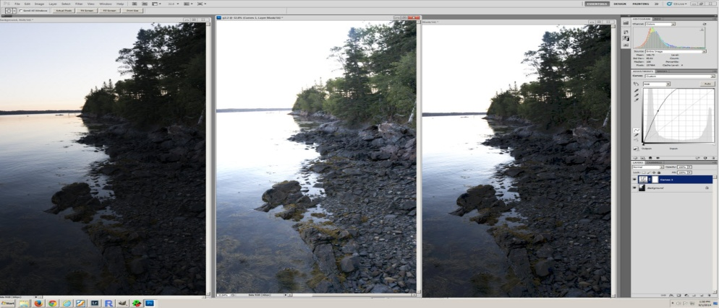
Gamma correction
What looks bright on one computer may look dark on another.
Problems in graphics:
Need to maintain color consistency across different platforms and hardware devices (monitor, printer, etc.)
Even the same type/brand of monitors change gamma values over time
Raw Linear Image
Gamma Corrected 2.2
Gamma Corrected 1.8

Slide 17

Additive and subtractive color mixture
Available color systems are dependent on the medium with which a designer is working.
When printing/painting, an artist has a variety of paints to choose from, and mixed colors are achieved through the subtractive color method.
When a designer is utilizing the computer screen to generate digital media, colors are achieved with the additive color method.
When we mix colors using paint, or through the printing process, we are using the subtractive color method. Subtractive color mixing means that one begins with white and ends with black; as one adds color, the result gets darker and tends to black
The CMYK (Cyan-Magenta-Yellow-Black) color system is the color system used for printing.

Slide 18

Additive and subtractive color mixture (cont.)
If we are working on a computer, the colors we see on the screen are created with light using the additive color method. Additive color mixing begins with black and ends with white; as more color is added, the result is lighter and tends to white
The RGB (Red-Green-Blue) colors are light primaries and colors are created with light.

Slide 19
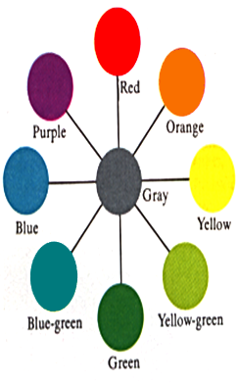
Complementary Hues – Additive Mixture
Complementary hues: Any hue will approach gray if additively mixed with it’s opposite hue on the color circle. Such hue pairs are complementary. Of particular importance are the pairs that contain four unique hues: red-green, blue-yellow “complementary hues”
Note that combining two complementary hues can never equal gray. For example, adding green to red will give you a yellowish gray, which is more neutral than the initial red
Notes:
Aligned color wheel with rest of slide

Slide 20
Color Contrast
The gray patches on the blue and yellow backgrounds are physically identical, yet look different
Difference in perceived brightness: patch on blue background looks brighter than one on yellow. Result of brightness contrast
Also a difference in perceived hue. Patch on blue looks yellowish, while patch on yellow looks bluish. This is color contrast: hues tend to induce their complementary colors in neighboring areas

Slide 21
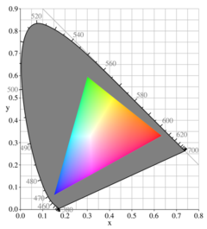
Color Gamut
Definition of GAMUT
The subset of colors which can be accurately represented within a given color space or by an certain output device and ink combination.
The complete set of colors found within an image at a given time. Converting a digitized image to a different color space, or printing it to a given medium generally alters its gamut.
The gray area represents the entire chromatic range. The colored triangle represents the color display.

Slide 22
Color models
Color Model (Color Space, Color System)
Specify colors in a standard way
A coordinate system that each color is represented by a single point.
Most used models:
RGB model (Monitor/TV)
CYM model (3-color Printers)
CYMK model (4-color Printers)
HSI model (Color Image Processing and Description)

Slide 23
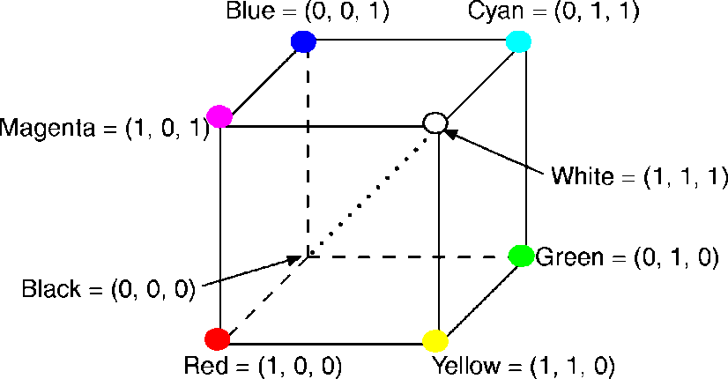
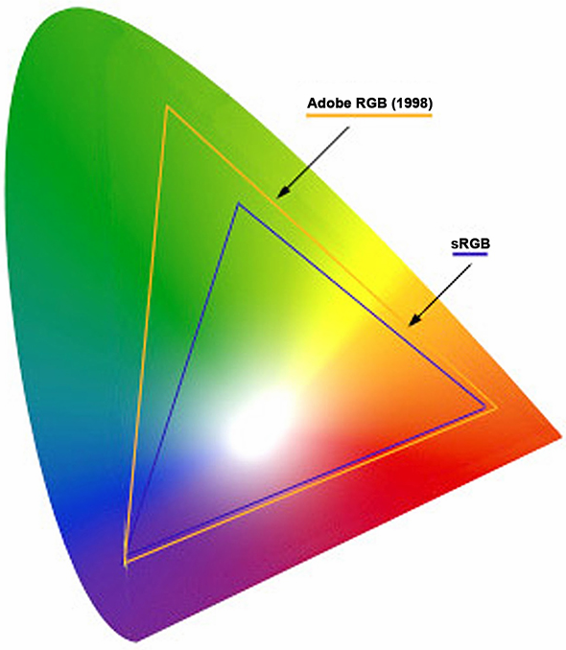
The RGB Color Model
RGB primaries are additive (RGBA)
The RGB cube (Grays are on the dotted main diagonal)
Main diagonal => gray levels
black is (0, 0, 0)
white is (1, 1, 1)
RGB color gamuts
differs from one display to another
differs by company too:
Adobe RGB - larger space
Currently the standard for digital photography
sRGB (HP/Microsoft) - fewer colors, but allocated bit depth better and more than enough for most on-screen and Web uses
Most monitors now cover 100% of sRGB space
Adobe RGB
sRGB

Slide 24
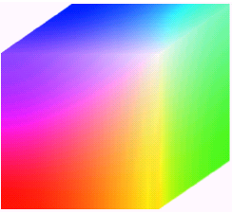
RGB Color Model
Pixel Depth: The number of bits used to represent each pixel in RGB space.
Full-color image: 24-bit RGB color image.
(R, G, B) = (8 bits, 8 bits, 8 bits)
Number of colors:
(2⁸)³ = 16,777,216

Slide 25
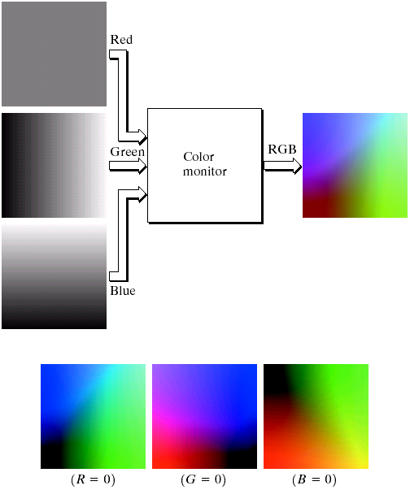
RGB Color Model
Color Image Generation
Color Image Acquisition

Slide 26
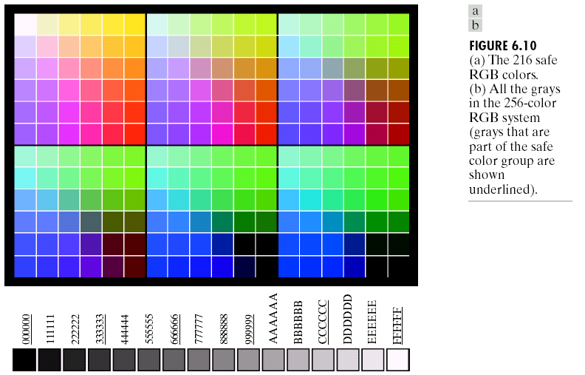
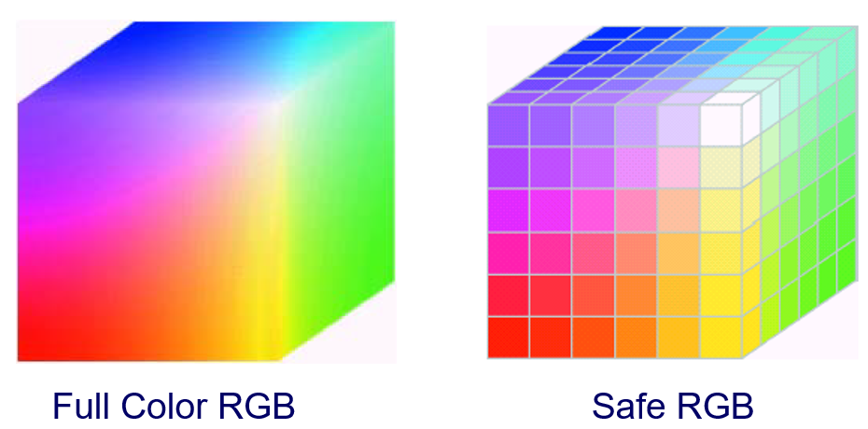
RGB Color Model
Save RGB colors
Subset of colors is enough for some application
Safe RGB colors (safe Web colors, safe browser colors)
Only 6 levels of each primary colors are used.
6³ = 216

Slide 27
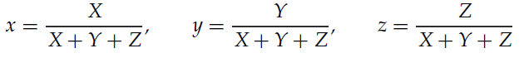
Standard Primaries and the Chromaticity Diagram
Because no finite set of light sources can be combined to display all possible colors, three standard primaries were defined in 1931 by the International Commission on Illumination, referred to as the CIE (Commission Internationale de l’ ´ Eclairage).
The set of CIE primaries is generally referred to as the XYZ color model, where parameters X, Y, and Z represent the amount of each CIE primary needed to produce a selected color. Thus, a color is described with the XYZ model in the same way that we described a color using the RGB model.
In discussing color properties, it is convenient to normalize the amounts in Equation against the sum X + Y + Z, which represents the total light energy. Normalized amounts are thus calculated as
Because x+y+z = 1, any color can be represented with just the x and y amounts

Slide 28
Chromaticity Diagram
Color composition as a function of red (x-axis) and green (y-axis).
Blue = 1 – Red – Green.
Not all color in chromaticity diagram are enclosed by a triangle!
With three single primary color we can NOT have all possible color!

Slide 29
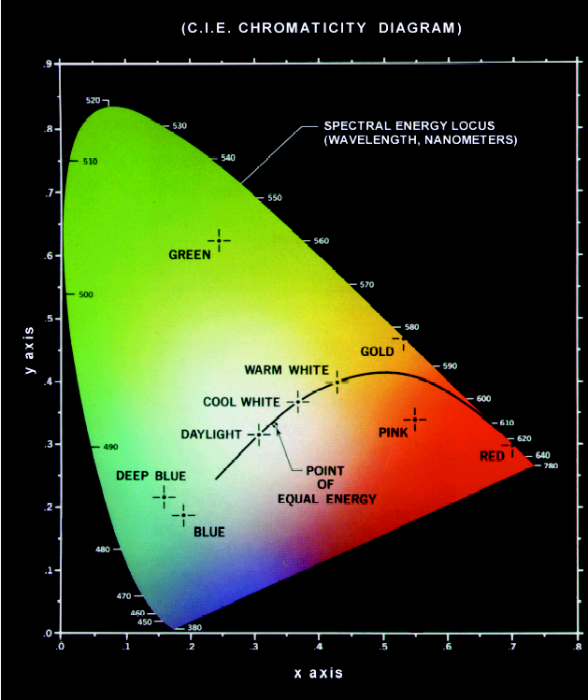
5. Color Mixing with various value of 2 colors
2. Mixed Color
6. Color Mixing with various value of 3 colors
1. Boundary are full saturated (Pure Color)
3. CIR White (1/3, 1/3, 1/3) - zero saturation
4. All shade of Pure color

Slide 30
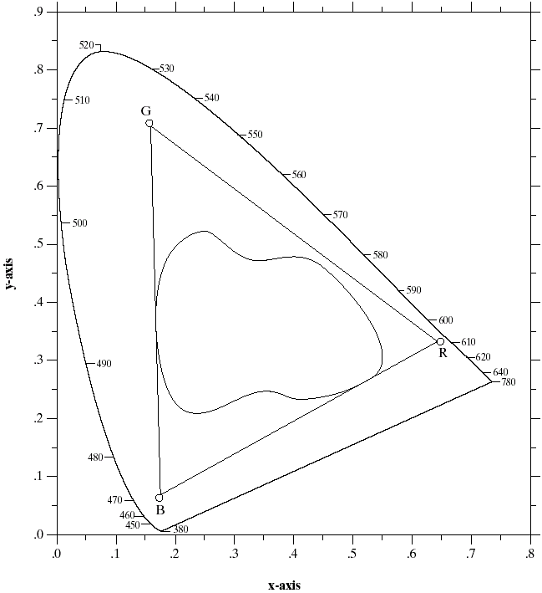
Chromaticity Diagram
Chromaticity Diagram
Monitor colors
Printers Inks

Slide 31
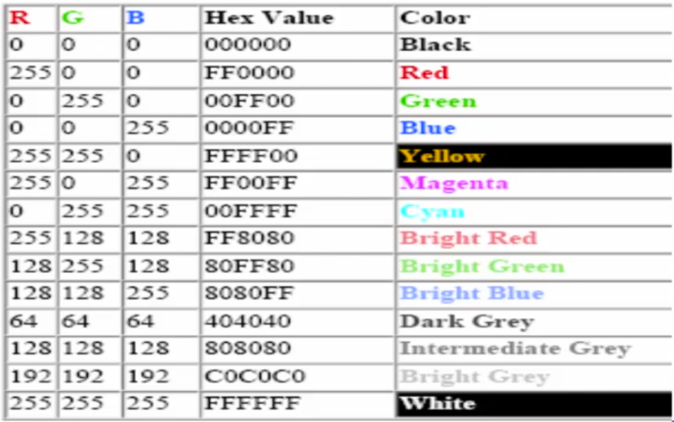
RGB color values

Slide 32
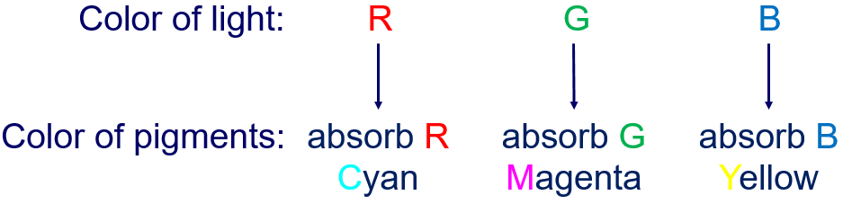
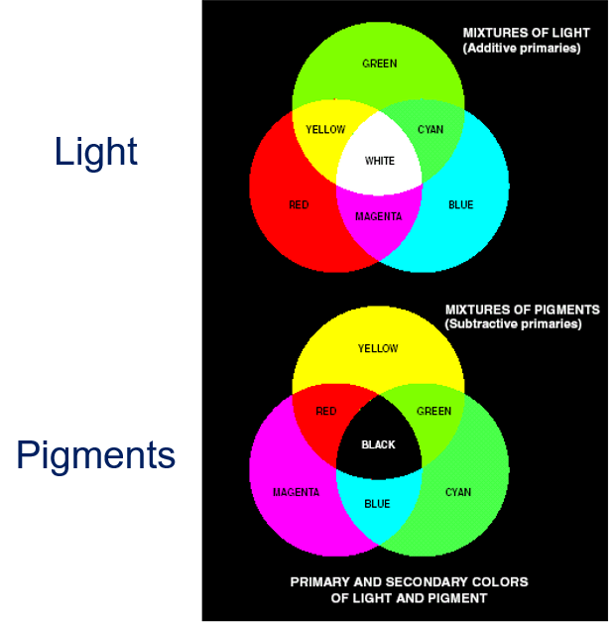
Light and pigments
Primary colors of light and primary colors of pigments (colorant):
Problem is application dependent:
R-G-B: Primary for Color TV.
C-M-Y: Primary for Color Printer.

Slide 33
The CMY(K) Color Model
Used in electrostatic and in ink-jet plotters that deposit pigment on paper
Cyan, magenta, and yellow are complements of red, green, and blue
Subtractive primaries: colors are determined by what is subtracted from white light, rather than by what is added to blackness
white is at origin, black at (1, 1, 1):
Green
Yellow
(minus blue)
(minus red)
Cyan
Black
Red
Blue
Magenta
(minus green)
subtractive primaries (cyan, magenta, yellow) and their mixtures

Slide 34

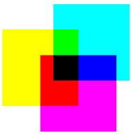
RGB and CMYK
RGB and CMYK are two different color spaces. The RGB color space uses light in colors of red, green, and blue to create the visible spectrum. Our eyes see color in terms of reflected light, so the observed world is closer to RGB than CMYK. That is why native RGB devices that use light to create color, such as film recorders, scanners, and cameras can reproduce color fairly accurately.
RGB. Three colors of light, red, green and blue make white light. Cyan, magenta and yellow are also combinations of RGB.
The intensity of light also changes the color.
CMYK. Three inks, cyan, magenta and yellow make black. In practice this black lacks intensity, so a separate black (K) is usually added. Red, green and blue are made from CMYK.

Slide 35
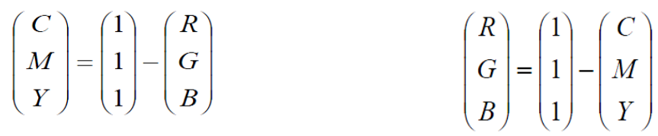
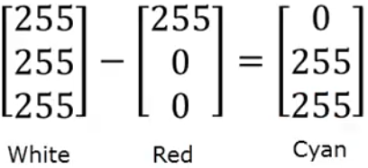
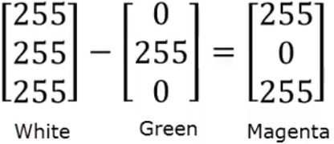
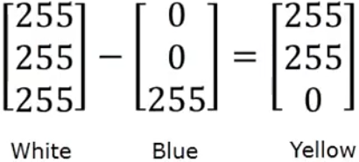
RGB and CMYK

Slide 36
CMY and CMYK Color Models
CMY: Secondary colors of light, or primary colors of pigments are used.
Used to generate hardcopy output (Printer and Copier).
Some facts:
Printer papers are white (reflect all colors)
Printers use ink (Transparent)
Cyan-Magenta-Yellow Pigments (ink) absorb Red-Green-Blue
K (Black) is practical problem of C+M+Y≠Black (Muddy Brown). Add a fraction of Black color

Slide 37
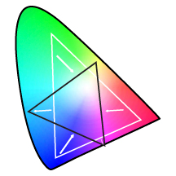
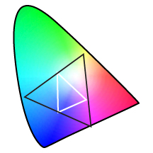
Rendering Intent Perceptual
Graphic to be printed
Printer
Relationships among colors are preserved
Color space is uniformly shifted
Absolute colors are not preserved
Technically reversible depending on RIP

Slide 38

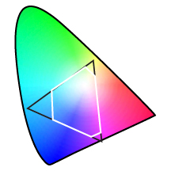
Rendering Intent Absolute Colorimetric
Graphic to be printed
Printer
In gamut colors are preserved
Out of gamut colors are shifted
Not reversible

Slide 39
RGB and HSV/HSI/HSL Color Space Conversion
HSV (hue-saturation-value), HSI (hue-saturation-intensity) and HSL (hue-saturation-lightness) are the three most common cylindrical-coordinate representations of points in an RGB color model.
The HSV/HSI/HSL representations rearrange the geometry of RGB in an attempt to be more intuitive and perceptually relevant.
The representations HSV, HSI and HSL are very similar, but not completely identical.

Slide 40
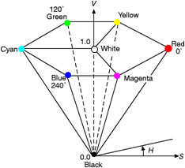
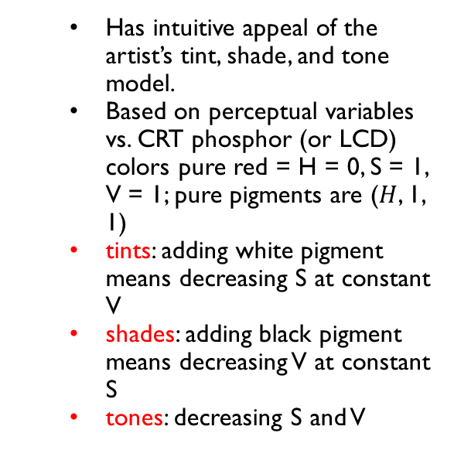
The HSV Color Model
Hue, saturation, value (brightness)
HSV-space invented by Alvy Ray Smith—described in his 1978.
Hexcone subset of cylindrical (polar) coordinate system
Single hexcone HSV
color model. The
cross-section at V = 1
contains the RGB model’s
R = 1, G = 1, B = 1
Value dimension resembles the mixture of those paints with varying amounts of black or white paint
Has intuitive appeal of the artist’s tint, shade, and tone model.
Based on perceptual variables vs. CRT phosphor (or LCD) colors pure red = H = 0, S = 1, V = 1; pure pigments are ($H$, 1, 1)
tints: adding white pigment means decreasing S at constant V
shades: adding black pigment means decreasing V at constant S
tones: decreasing S and V

Slide 41
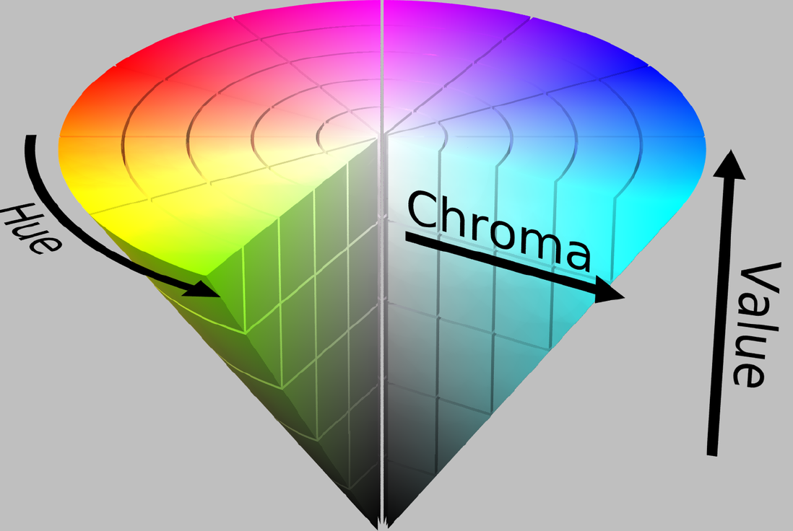

Slide 42
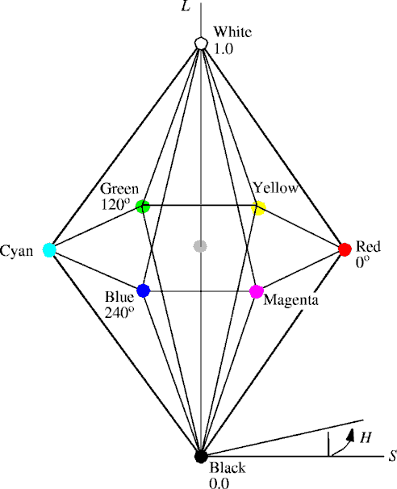
The HLS Color Model
Hue, lightness, saturation
Double-hexcone subset of XYZ space
Maximally saturated hues are at S = 1, L = 0.5
Less attractive for sliders or dials
Conceptually easier for some people to view white as a point
As Hue varies, the corresponding colors vary from red, through yellow, green, cyan, blue, and magenta, back to red.

Slide 43
The HLS Color Model
Hue, lightness, saturation
Double-hexcone subset of XYZ space
Maximally saturated hues are at S = 1, L = 0.5
Less attractive for sliders or dials
Conceptually easier for some people to view white as a point
Saturation is the intensity of a hue from gray tone (no saturation) to pure, (high saturation).

Slide 44
The HLS Color Model
Hue, lightness, saturation
Double-hexcone subset of XYZ space
Maximally saturated hues are at S = 1, L = 0.5
Less attractive for sliders or dials
Conceptually easier for some people to view white as a point
Lightness is the relative brightness or darkness of a particular color, from black (no lightness) to white (full lightness).

Slide 45
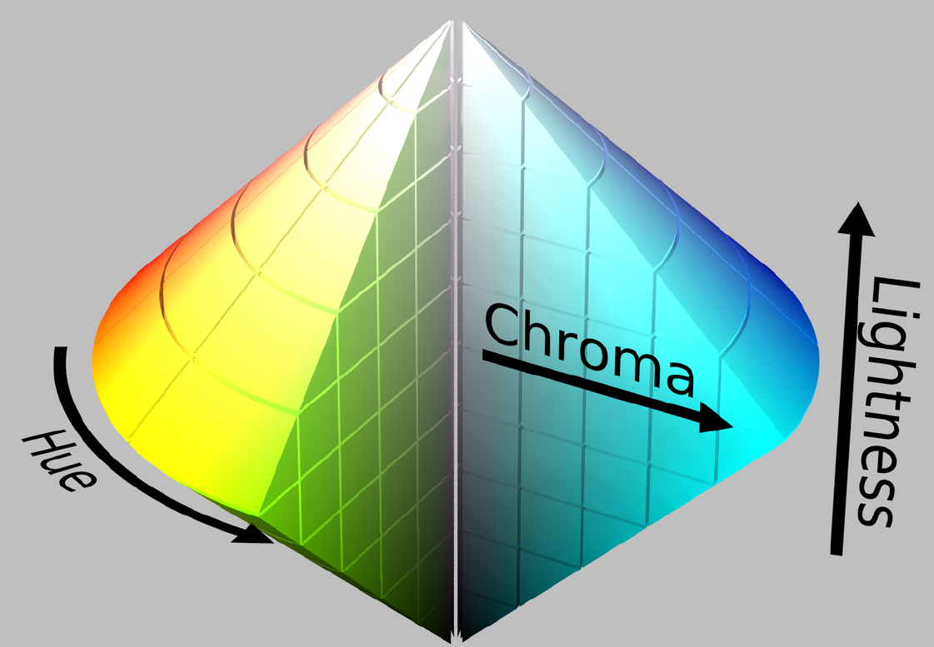

Slide 46
HSI Color Model
Human description of color is not RGB or CMYK
Human description of color is Hue, Saturation and Brightness:
Hue: color attribute
Saturation: purity of color
Brightness: achromatic notion of intensity

Slide 47
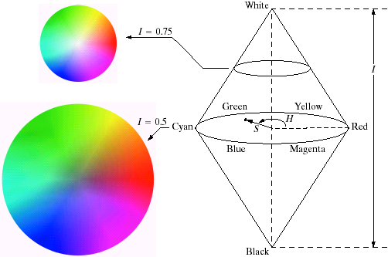
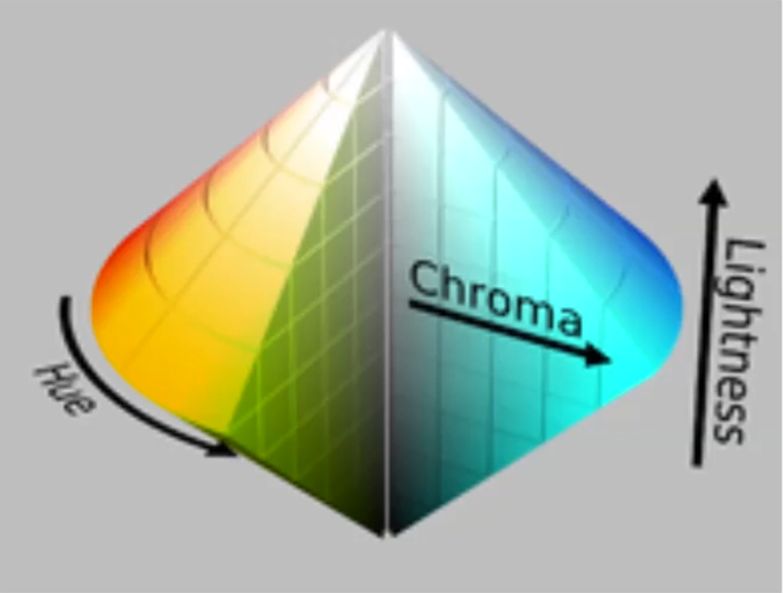
HSI Color Model

Slide 48
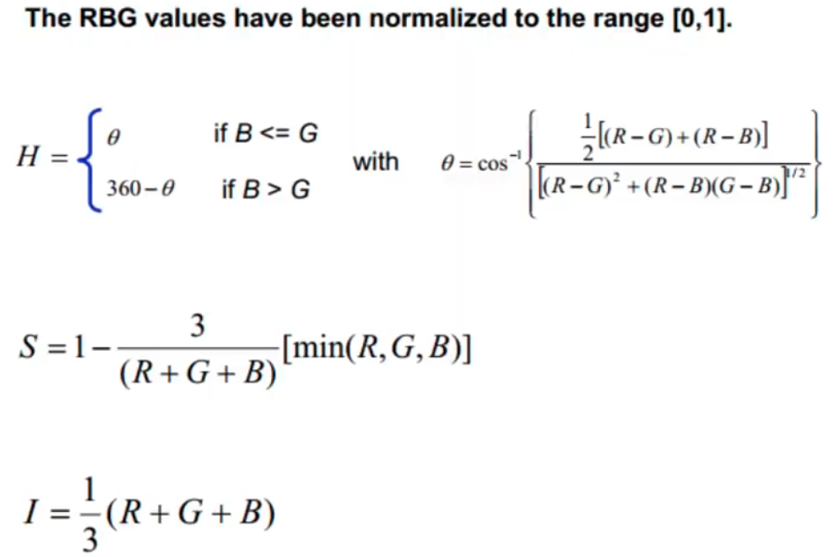
Convert RGB model to hsi

Slide 49
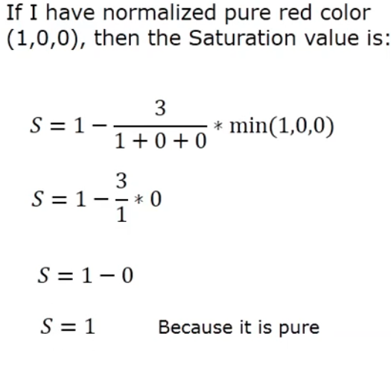
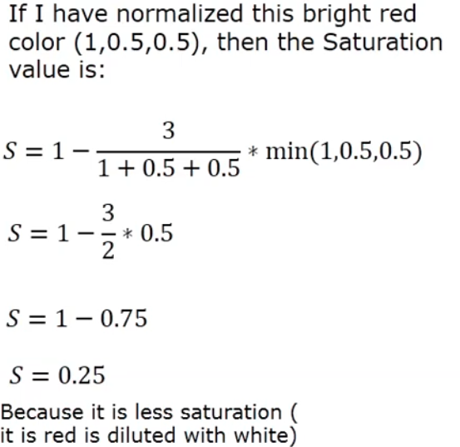
Example

Slide 50
HSV, HIS, and HLS
The hue component H in all three color spaces is an angular measurement, analogous to position around a color wheel.
A hue value of 0°corresponds to red, 120° corresponds to green, and 240° corresponds to blue.
The saturation component in all three color spaces describes color intensity.
A saturation value of 0 (in the middle of a hexagon) means that there is no color (gray). A saturation value at the maximum (at the outer edge of a hexagon) means that the colorfulness value is at maximum for the color defined by the hue.
HSV model is called a single hexagon model. The top of the hexagon corresponds to maximum intensity V=1.
The maximum saturation is available for maximum intensity. The bottom converges to one point that corresponds the color black.

Slide 51
HSV, HIS, and HLS
The HSI model is called a double hexagon model. The bottom is similar to HSV but the top also converges to one point that corresponds to the color white. The line between top point and bottom point corresponds to varying shades of gray.
For the HSI model, the maximum saturation is available at a medium grey intensity.
The pseudo-lightness dimension I in HSI is given by the formula (r+g+b)/3
The HSL model is also a double hexagon model, where lightness is defined as the average of the largest and smallest color components.
The parameter L in HLS space has a particularly tenuous connection with perceived lightness.

Slide 52
Yiq model
Recoded RGB for transmission efficiency, compatibility with B/W broadcast TV;
used for NTSC (National Television Standards Committee (cynically, “Never The Same Color”))
Y = CIE’s Y (luminance); I and Q encode chromaticity

Slide 53
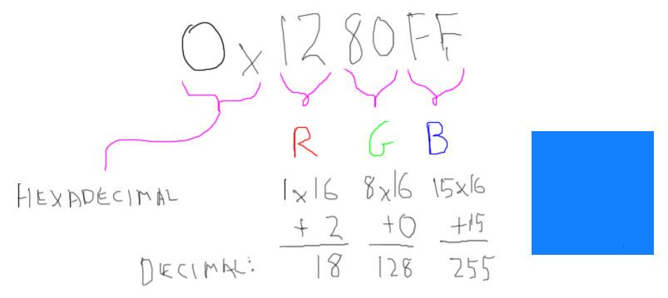
Color definition
We usually define colors in one of two ways: as floating point numbers, or as integers. [ float 0.0 to 1.0 or integer 0 to 255 ]
[ (0.0, 0.0, 0.0) RGB is black (1.0, 1.0, 1.0) RGB is white (1.0, 0.0, 0.0) RGB is red (0.0, 1.0, 0.0) RGB is green (0.0, 0.0, 1.0) RGB is blue]
The value “0x1280FF” is a single number holding the R, G, and B channels all together.
The “0x” prefix means that this is a hexadecimal number, base 16, where the letter A means 10, B means 11, on up to F meaning 15.

Slide 54
An Introduction to Color Theory and Color Palettes
User interface (UI) designers have the challenging task of incorporating color into their interface in a way that poignantly communicates a brand’s visual identity.
While it might seem like a website’s color palette is a matter of the client’s personal taste, in reality, UI designers rely on a framework called color theory: a multilayered set of guidelines that informs the use of color in design.
Color theory is a framework that informs the use of color in art and design, guides the curation of color palettes, and facilitates the effective communication of a design message on both an aesthetic and a psychological level.
Modern color theory is largely based on Isaac Newton’s color wheel, which he created all the way back in 1666. The basic color wheel displays three categories of color; primary colors, secondary colors, and tertiary colors.

Slide 55
An Introduction to Color Theory and Color Palettes
Primary colors are colors you can’t create by combining two or more other colors. The primary colors are red, blue, and yellow.
The secondary colors are orange, purple, and green—in other words, colors that can be created by combining any two of the three primary colors.
Tertiary colors are created by mixing a primary color with a secondary color. The tertiary colors are magenta, vermillion, violet, teal, amber, and chartreuse.

Slide 56
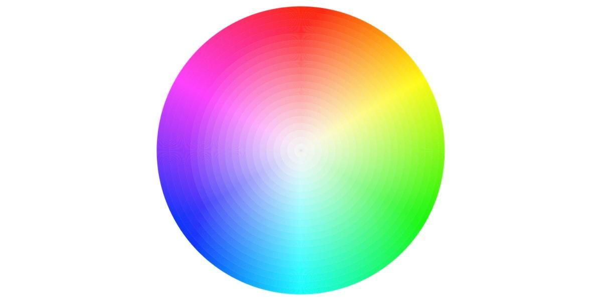
Introduction to the color wheel
An artist creates a color painting by mixing color pigments with white and black pigments to form the various shades, tints, and tones in the scene.
The color wheel doesn’t just chart each primary, secondary, and tertiary color—it also charts their respective hues, tints, tones, and shades.
By visualizing how each color relates to the color that comes next to it on a rainbow color scale, the color wheel helps designers to create bespoke color palettes that promote aesthetic harmony. Let’s dive into these color variants a little deeper:

Slide 57
Introduction to the color wheel
Hue
Hue refers to the pure pigment of a color, without tint or shade. In that respect, hue can be interpreted as the origin of a color. Any one of the six primary and secondary colors is a hue.
Shade
Shade refers to how much black is added into the hue. As such, shade darkens a color.
Tint
The opposite of shade, tint refers to how much white is added to a color. As such, tint lightens a color.
Tone (or Saturation)
Tone is the result of a color that has had both white and black added to it. In other words, tone refers to any hue that has been modified with the addition of grey—as long as the grey is purely neutral (only containing white and black).

Slide 58
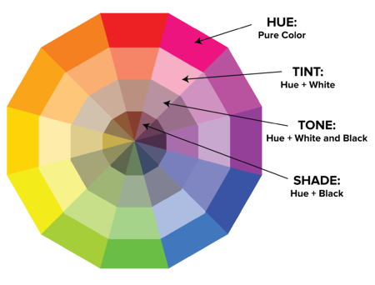
Introduction to the color wheel

Slide 59
Color temperature
Even if you’re a design beginner, you’ve likely heard the terms “warm, cool and neutral” terms. This is referred to as color temperature, and it’s an essential consideration when it comes to color theory:
Warm colors contain shades of yellow and red;
cool colors have a blue, green, or purple tint;
Neutral colors include brown, gray, black, and white.
The temperature of a color has a significant impact on our emotional response to it. Within the psychology of colors, for example, warm colors show excitement, optimism, and creativity, whereas cool colors symbolize peace, calmness, and harmony.

Slide 60
Introduction to color palettes
A color palette is a combination of colors used by UI designers when designing an interface. When used correctly, color palettes form the visual foundation of your brand, help to maintain consistency, and make your user interface pleasing and enjoyable to use.

Slide 61
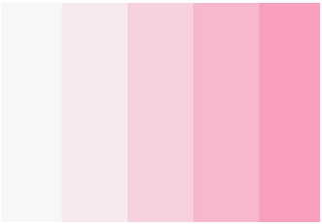
What are the different types of color palettes?
Monochromatic
A popular choice with designers, monochromatic color schemes are formed using various tones and shades of one single color.

Slide 62

What are the different types of color palettes?
Analogous
An analogous color scheme is formed of three colors that are located next to each other on the color wheel. Analogous color palettes are commonly used when no contrast is needed—for example, on the background of web pages or banners.

Slide 63
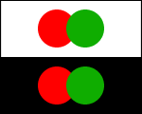
What are the different types of color palettes?
Complementary
Complementary color palettes are colors that are placed in front of each other on the color wheel. While the name may suggest otherwise, complementary color palettes are actually the opposite of analogous and monochromatic color palettes, as they aim to produce contrast. For example, a red button on a blue background will stand out on any interface.

Slide 64
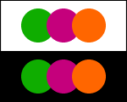
What are the different types of color palettes?
Split-complementary
The split-complementary color palette differs from the complementary color palette only in that it employs a higher number of colors. For example, if you choose the color blue, you’ll then need to take the two colors that are adjacent to its opposite color, which in this case would be yellow and red.

Slide 65
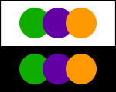
What are the different types of color palettes?
Triadic
The triadic color scheme is based on three separate colors that are equidistant on the color wheel. Most designers employ the triadic color scheme by choosing one dominant color, and using the other two colors as accents.

Slide 66

What are the different types of color palettes?
Tetradic (rectangle)
Commonly used by more experienced designers, the tetradic color scheme employs two sets of complementary pairs—four colors from the color wheel in total that should form a rectangle when connected. While it’s a little harder to balance, it makes for a visually stunning end effect

Slide 67

What are the different types of color palettes?

Slide 68
How to choose a color palette?
Research your audience
Consider color psychology
Use some UI conventions
Consider your color context.
Refer to a color wheel to identify analogous colors.

Slide 69

Color Tools
Adobe Color

Slide 70

Color Tools
Illustrator Color Guide

Slide 71

Color Tools
Preset Color Guides (Microsoft)

Slide 72

Color Tools
Coolors

Slide 73
Thanks

